Slide 1
Chapter 9 Introduction to Machine Learning

Slide 2
Learning Objectives
Understand the concept and history of machine learning .
Understand the difference between supervised and unsupervised learning .
Understand the concept of classification .
Understand the concept of regression .

Slide 3
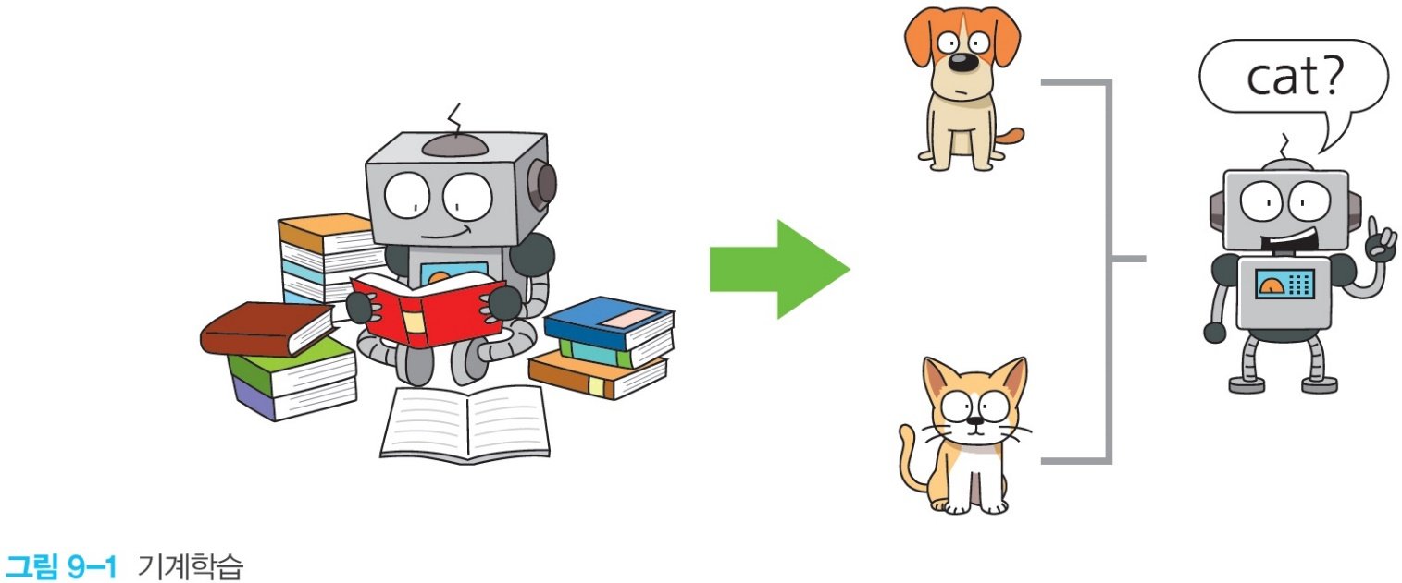
What is Machine Learning ?
Current computers cannot learn by themselves, so if we want a computer to do something, we must write a program and instruct it .
If computers can learn on their own, computers will be able to do many things without programming .

Slide 4
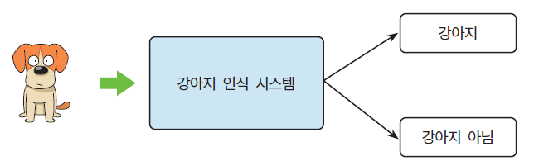
Differences between machine learning and traditional programming
Computers are used to solve human problems . The traditional approach is to ' program' the desired procedure . This is called explicit programming .
For example, consider the problem of distinguishing between dogs and cats . It is a task that is too easy for humans, but very difficult to construct in an algorithm . What should I do ?

Slide 5
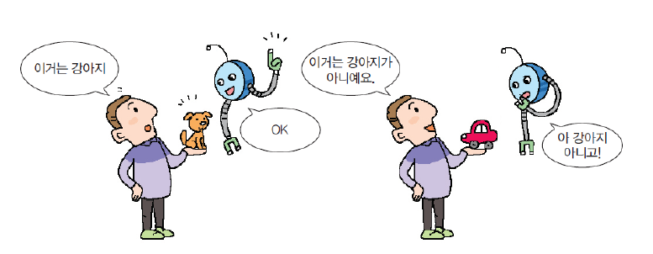
Differences between machine learning and traditional programming
What would happen if we approached this problem with machine learning ? We do not write programs that recognize dogs . You simply feed a bunch of pictures to the machine learning system and tell it which pictures are dogs .

Slide 6
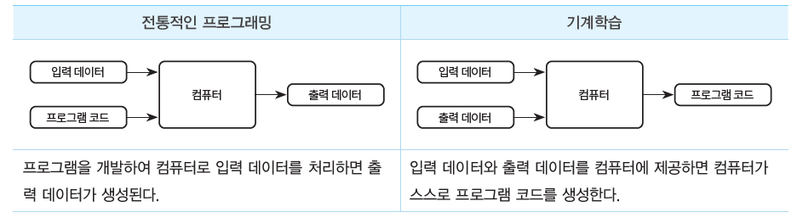
Differences between machine learning and traditional programming
In traditional programming, developers have to write specific program code . But in machine learning, you only need to provide data.

Slide 7
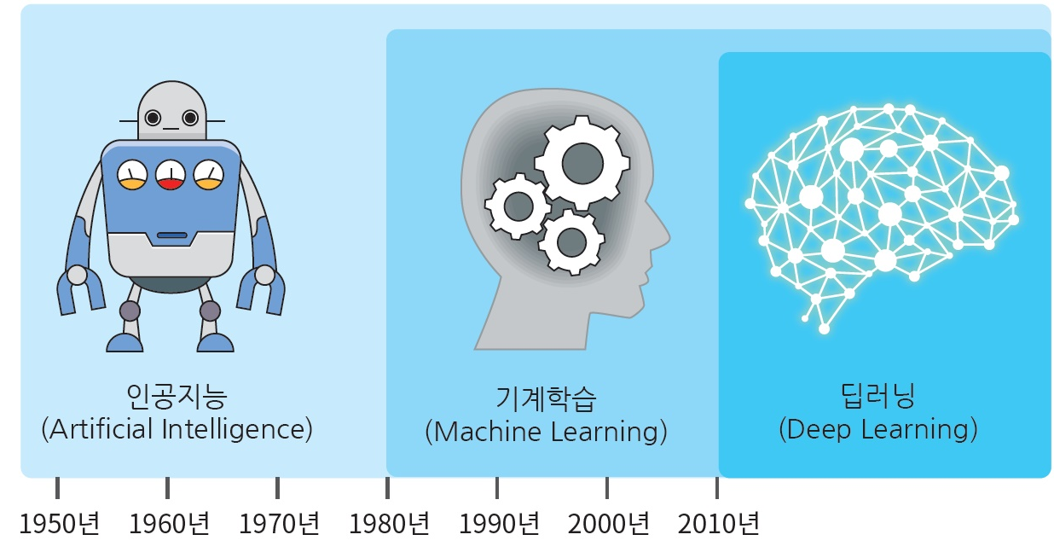
Artificial Intelligence , Machine Learning , Deep Learning

Slide 8
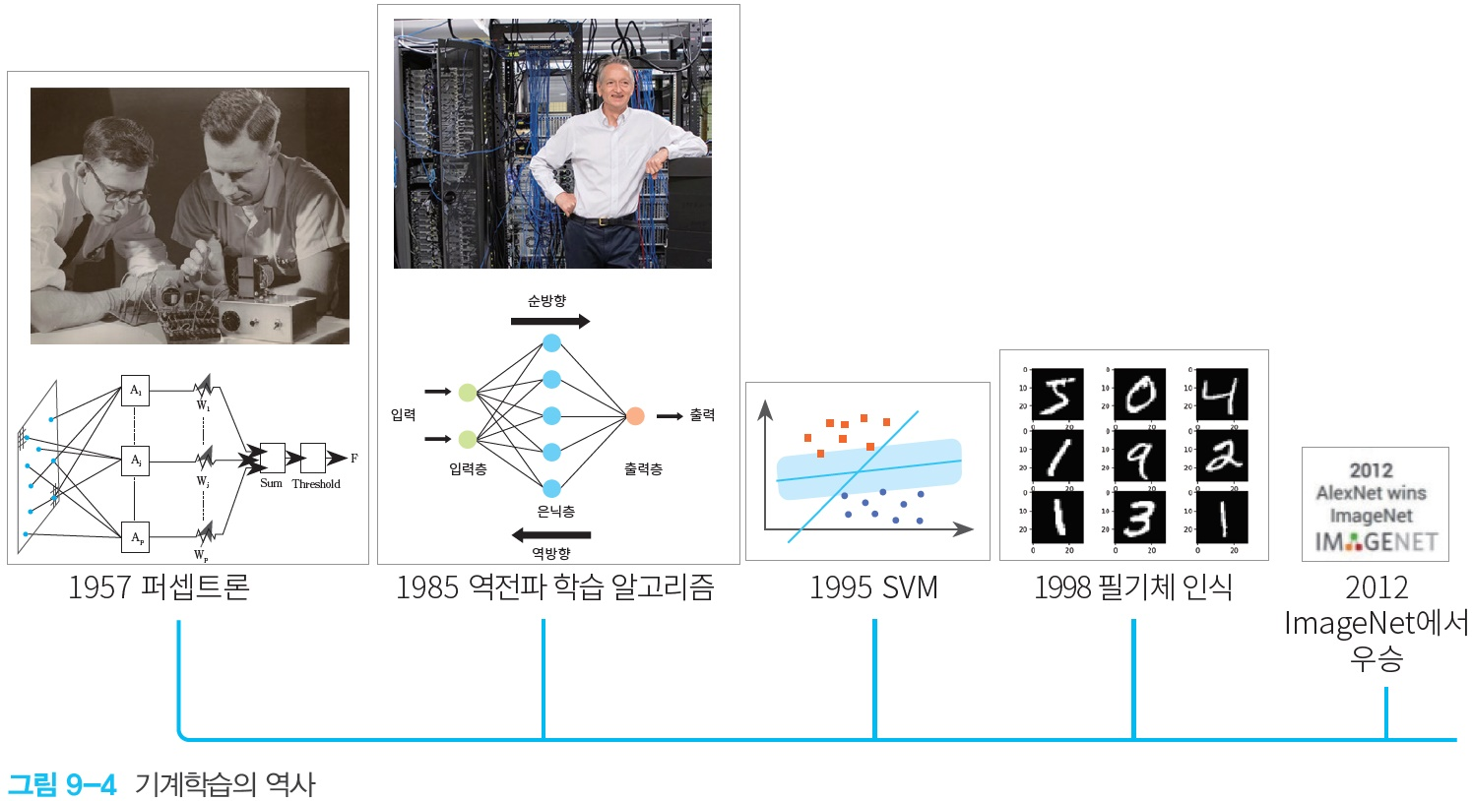
machine learning history

Slide 9
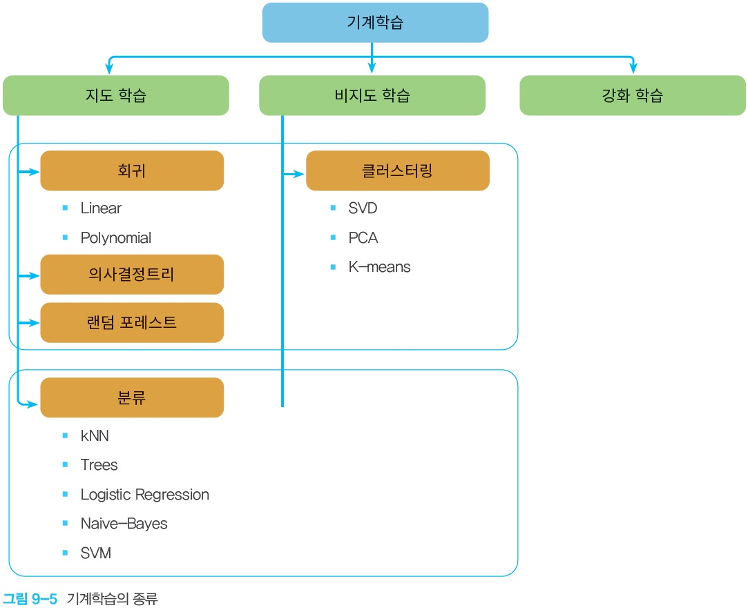

types of machine learning
Neural networks can be used in any field of machine learning !!!

Slide 10
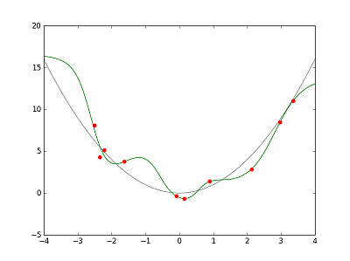
machine learning
machine learning as learning a function y = f(x) that always takes an input and outputs it . ( function approximation )
We learn the function
input
Print
machine learning == function approximation

Slide 11
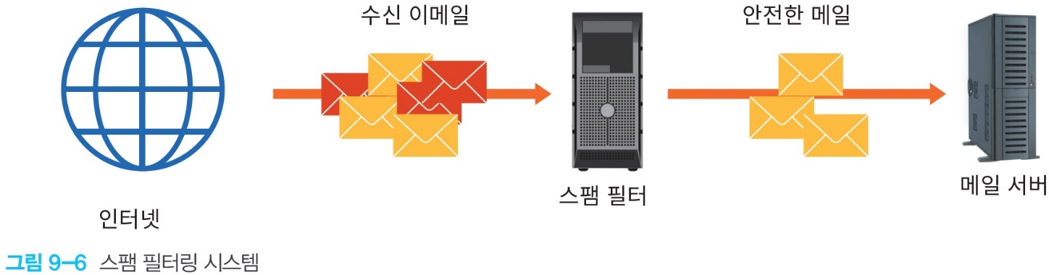
Features _
A feature is an input that we feed to the learning model . In the simplest case, the input itself is the feature .
( Example )
the email contains the text “ Prosecution” ( yes or no )
the email contains the strings “ad” , “ gift voucher” or “winner” ( yes or no )
Number of special symbols such as '★' in the subject or body of the email ( integer )
…

Slide 12
labels and samples
label _
Corresponds to the y variable in y = f(X) .
For example, a label could be the future price of a crop , the type of animal displayed in a photo , or the meaning of a video .
sample or example
A sample is a specific example given to machine learning . Corresponds to X in y = f(X) . There are labeled and unlabeled samples . For supervised learning, there must be a label .

Slide 13
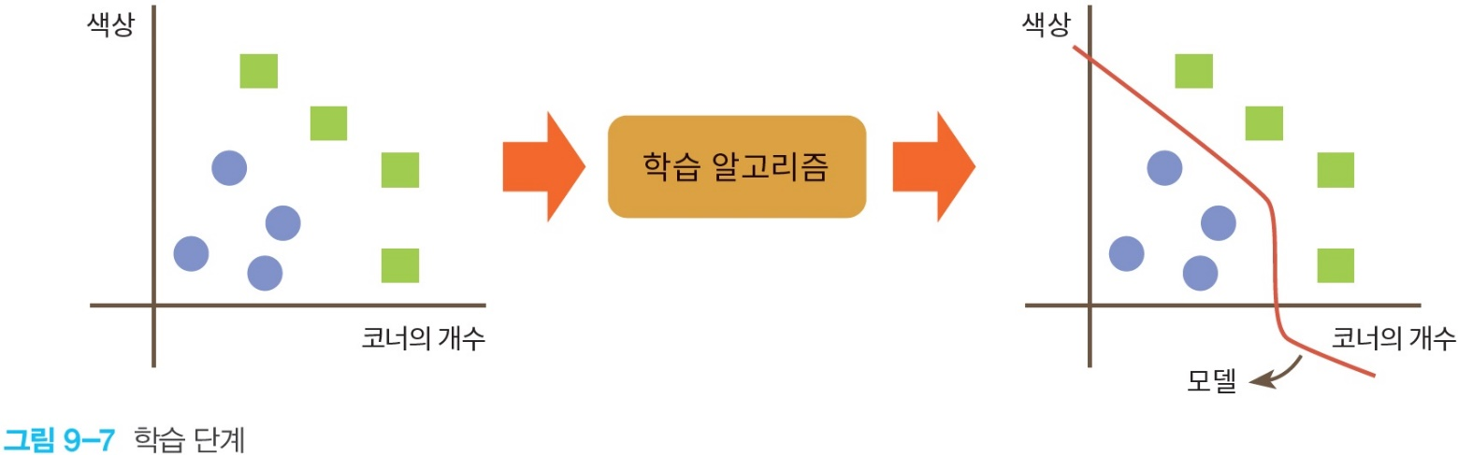
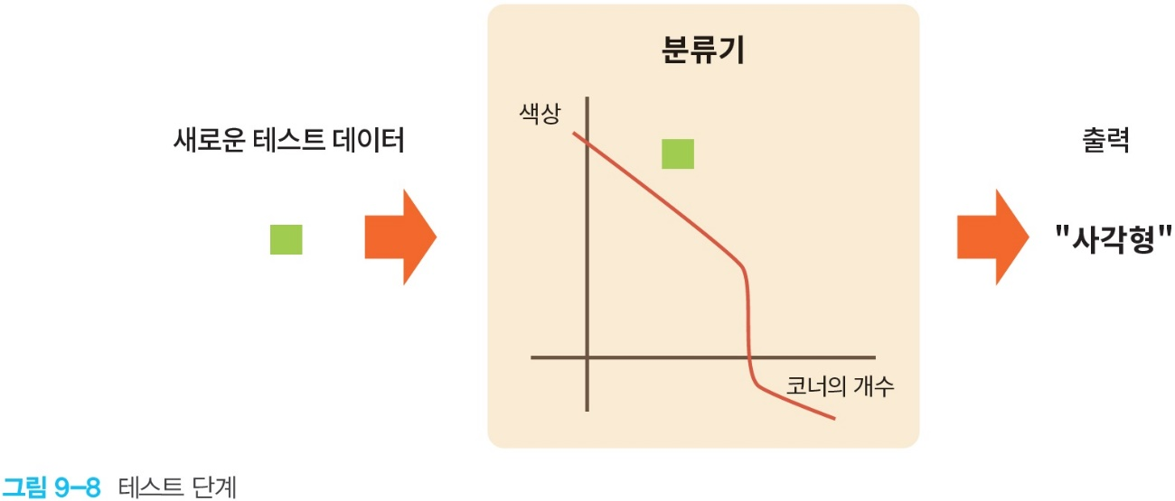
training and test data

Slide 14
learning and prediction
Learning means to build or learn a model .
Prediction means applying the learned model to unlabeled samples . That is, using the trained model to make useful predictions (y') .

Slide 15
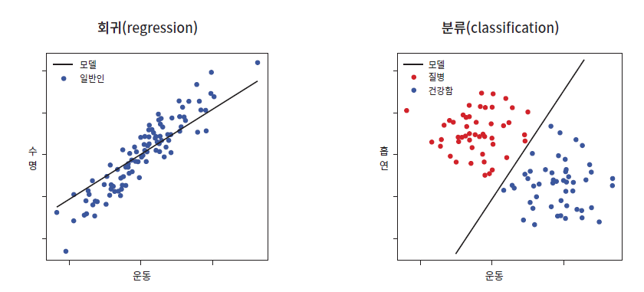
supervised learning
Supervised learning is a learning method in which there is a teacher who tells the correct answer . It can be largely divided into regression and classification .

Slide 16
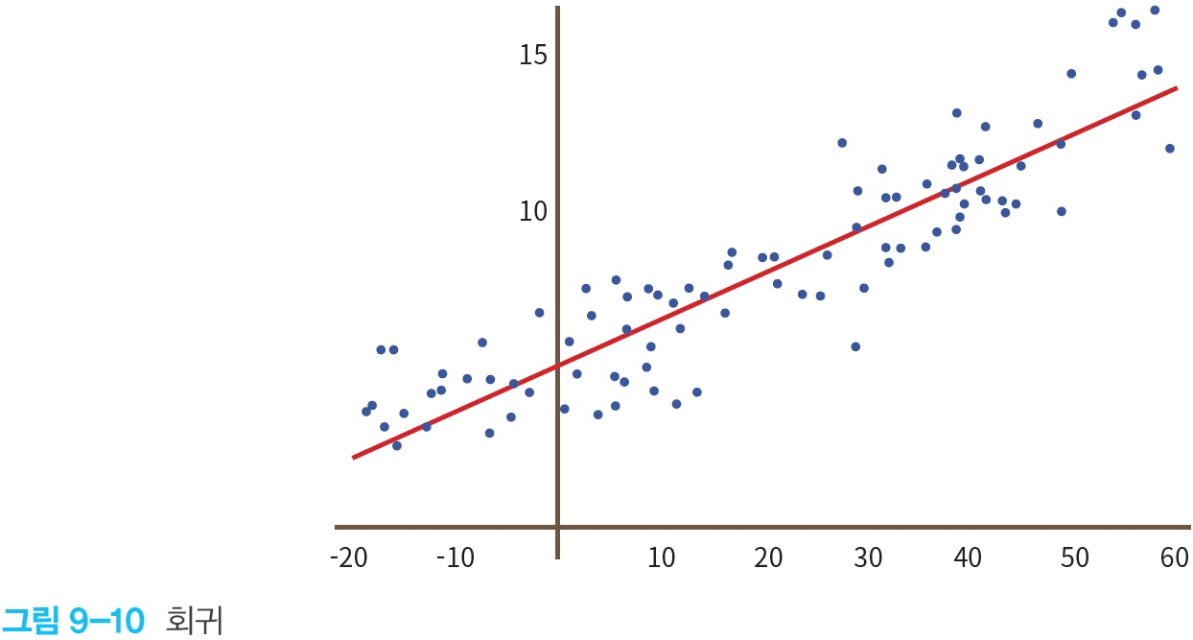
supervised learning
Regression : In regression, both inputs and outputs are real numbers .
“What is the probability that a user clicks on this ad ?”

Slide 17
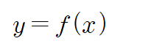
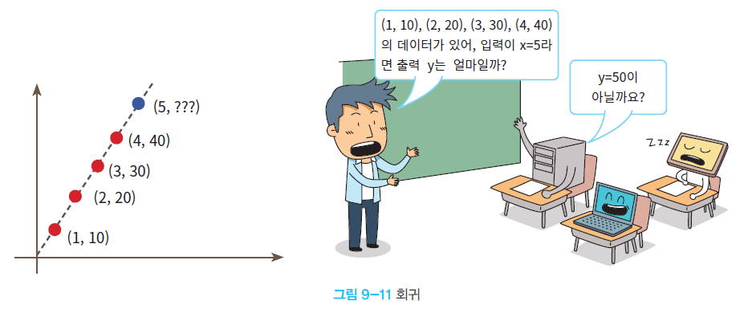
return
Regression can be thought of as learning a mapping function from inputs to outputs given real inputs (x) and real outputs (y) .

Slide 18
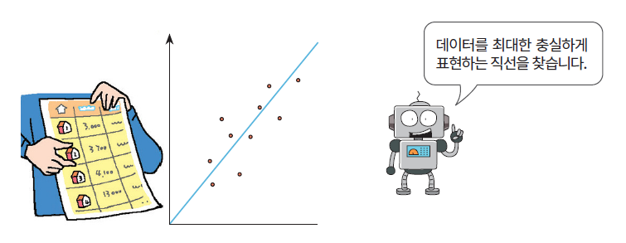
regression example
Consider an algorithm that predicts the price of an apartment in a specific area based on area . We can plot the price of each apartment by area as points on the graph as follows, and draw a straight line passing through the points as closely as possible .

Slide 19
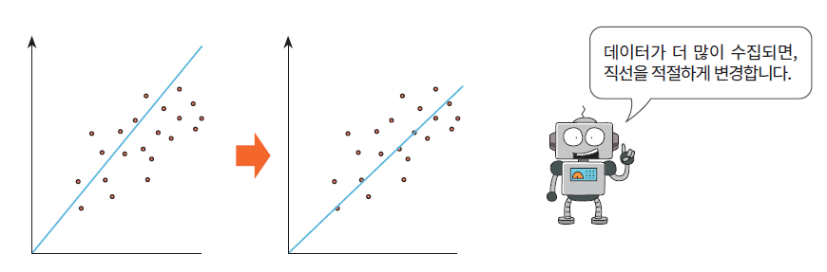
As more data is collected
New data can also be included if we adjust the slope of the straight line . This can be called learning in regression .

Slide 20
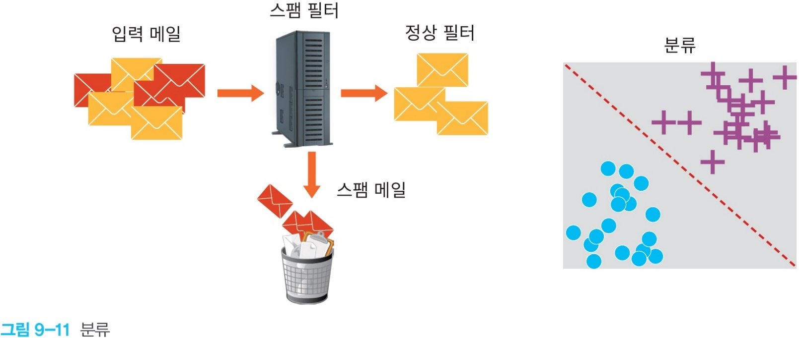
supervised learning
classification : splitting an input into two or more labels ( types )
When training the model, we need to provide labels .

Slide 21
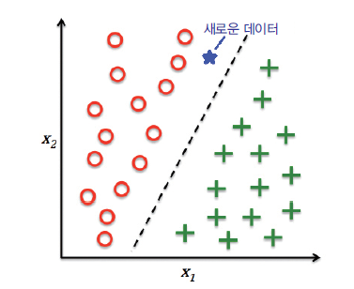
classification
We call this a classification problem ( or a recognition problem ) when the output y in the preceding equation y = f(x) is discrete .
involves dividing an input into two or more classes ( classes ) .
For example, looking at a picture and classifying it as “dog” or “cat” is a classification problem .

Slide 22
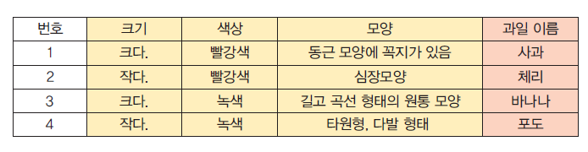
classification example
Looking at a fruit basket filled with lots of fruits , the program predicts the correct labels, such as bananas and oranges.

Slide 23
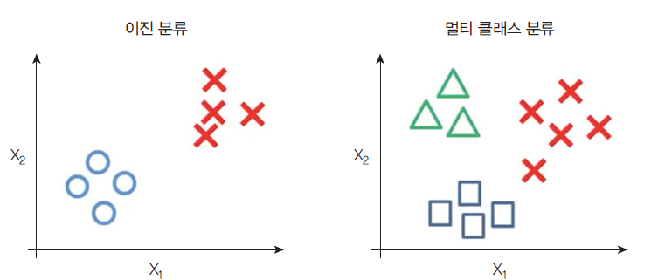
classification
Common algorithms for performing classification include neural networks , k-nearest neighbors ( kNNs ), support vector machines (SVMs), and decision trees .

Slide 24
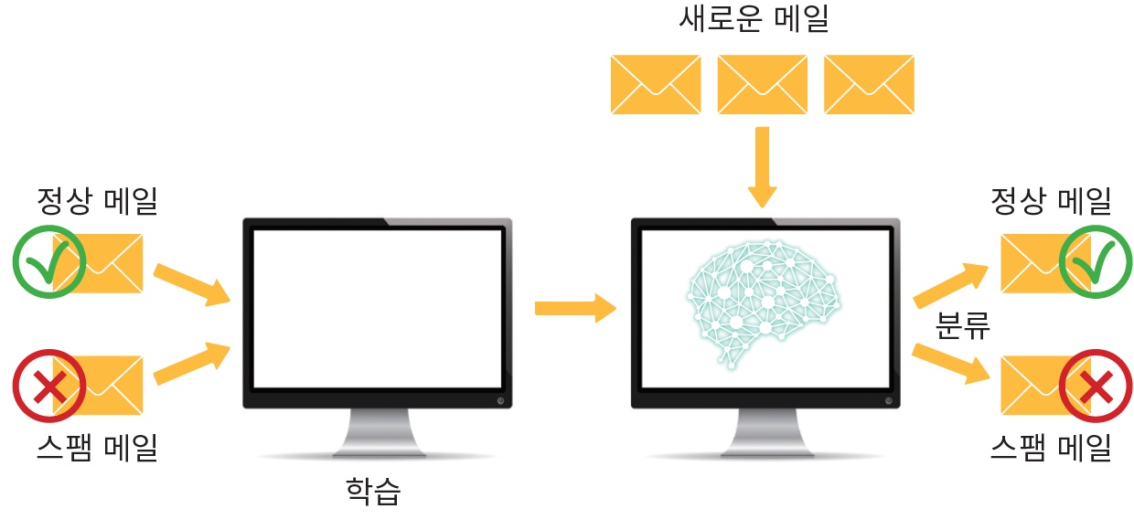
classification
We call this a classification problem ( or a recognition problem ) when the output y in the preceding equation y = f(x) is discrete .
Classification is the division of an input into two or more classes .

Slide 25
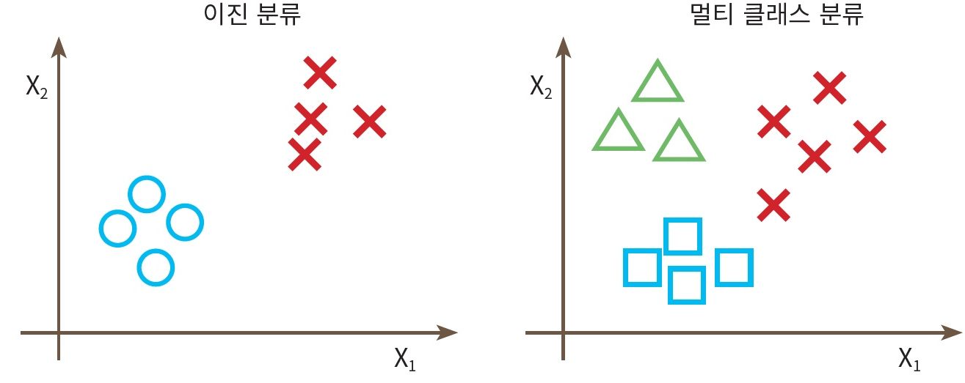
classification
Classification is generally done in the form of supervised learning .
Common algorithms for performing classification include neural networks , k-nearest neighbors ( kNNs ), support vector machines (SVMs), and decision trees .

Slide 26
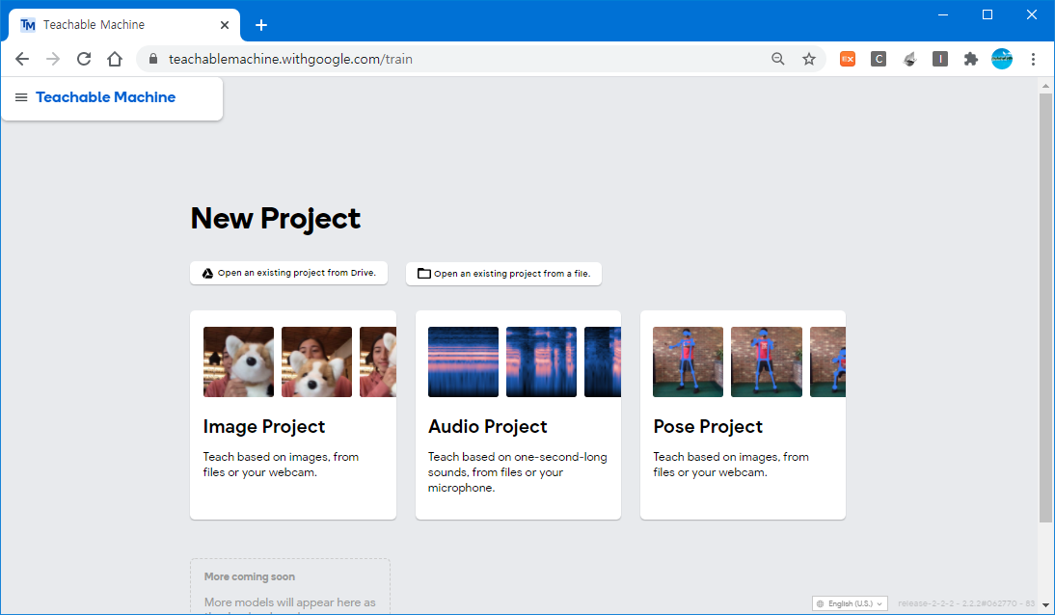
Lab: Experience machine learning using a teachable machine
We click on “ Image Project” to categorize the photos .

Slide 27
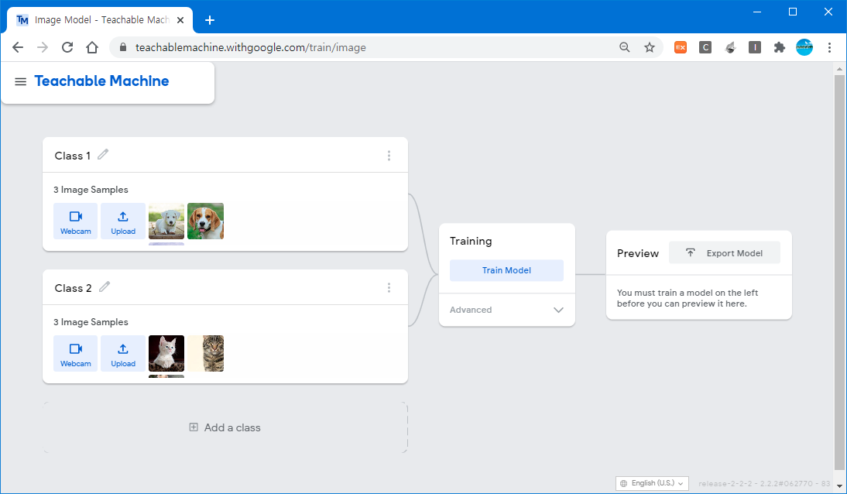
Lab: Experience machine learning using a teachable machine
Let's prepare 3 dog images and 3 cat images, learn and classify them .

Slide 28
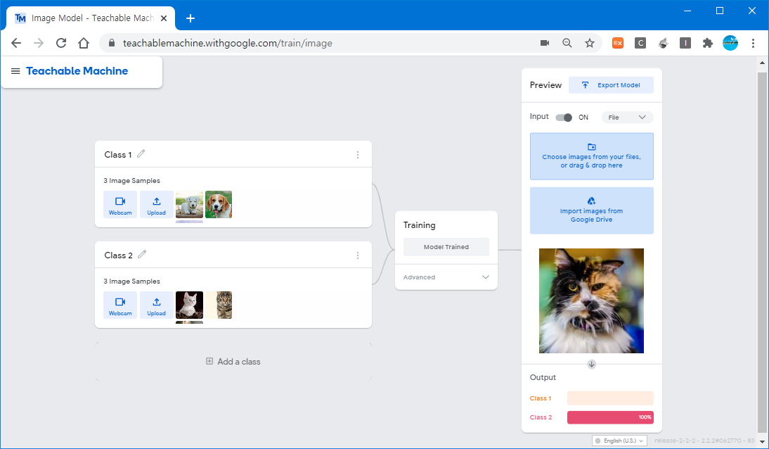
Lab: Experience machine learning using a teachable machine
the machine learning system, click the “ Train Model” button on the screen above . Let's download a new file and test it .

Slide 29
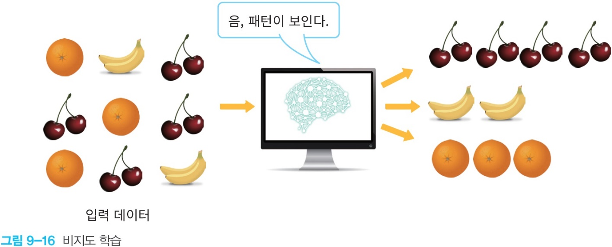
rain map learning
Unsupervised learning means that the computer classifies the inputs on its own without a “teacher” . In the expression y = f(x), the label y is not given .
It is possible to collect similar data by analyzing the correlation of data .

Slide 30
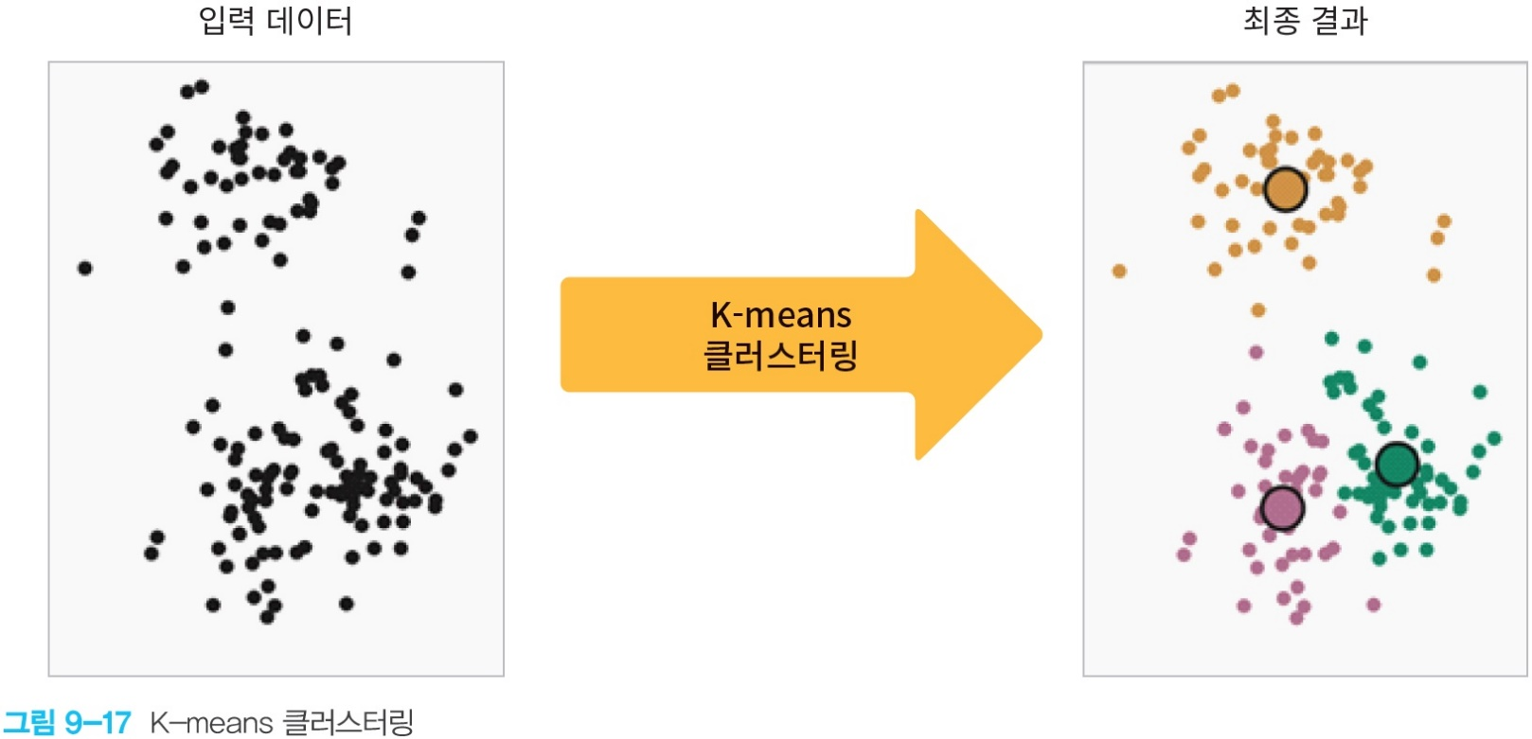
rain map learning
The most representative unsupervised learning is clustering .
Clustering is a method of dividing an input into several groups by calculating the distance between data .

Slide 31
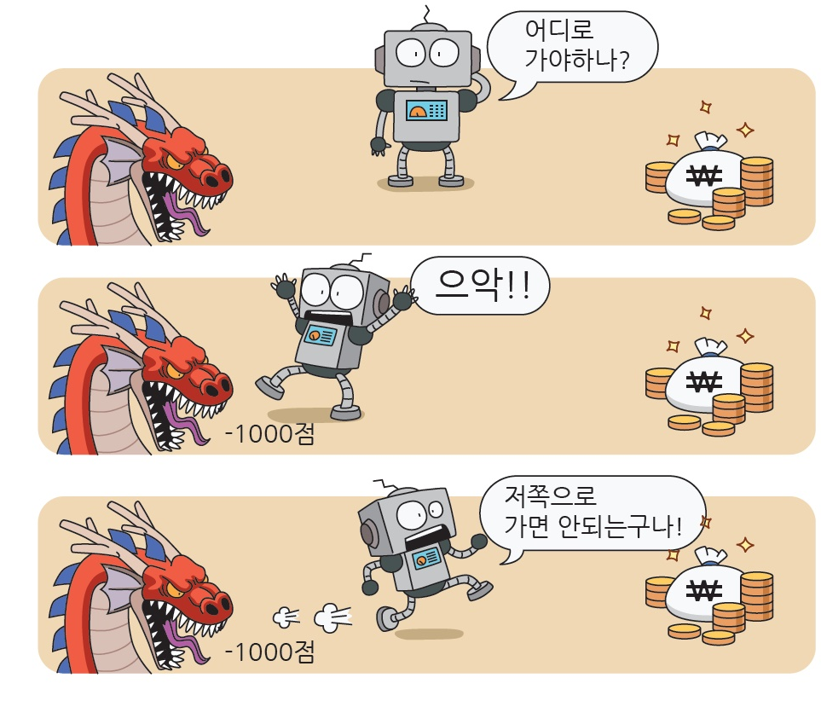
reinforcement learning
Reinforcement Learning , an external punishment or reward is given whenever the computer takes an action .

Slide 32
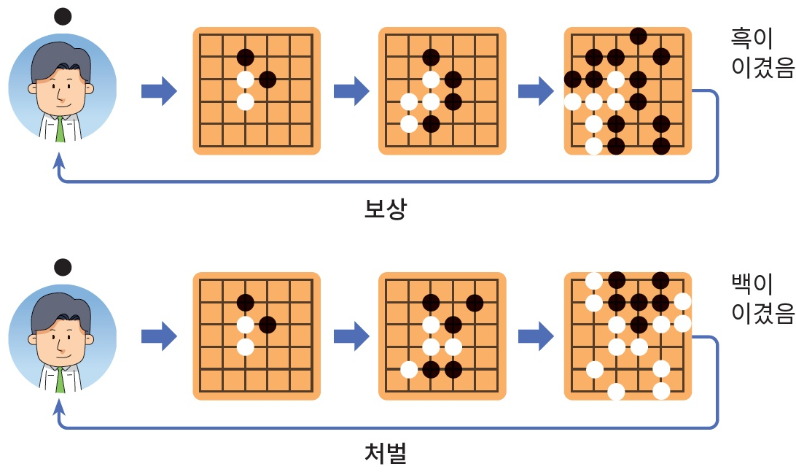
reinforcement learning
of AlphaGo also uses reinforcement learning.
Used a lot in games ( e.g. Frozen Lake).

Slide 33
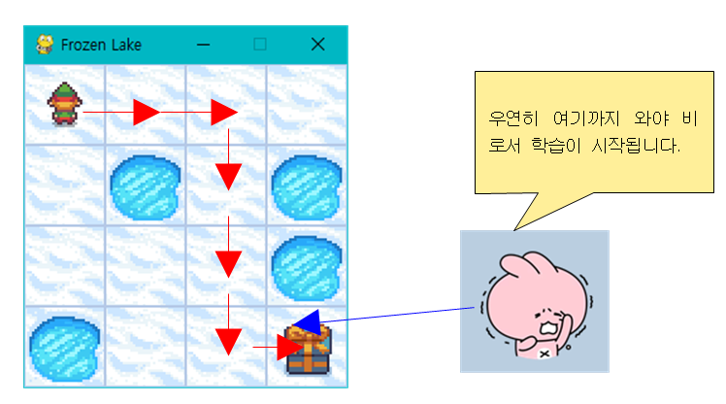
Difficulties in Reinforcement Learning
The difficulty with reinforcement learning is that just because the computer has taken an action, the result may not be immediate . This is called the “delay compensation” problem .

Slide 34
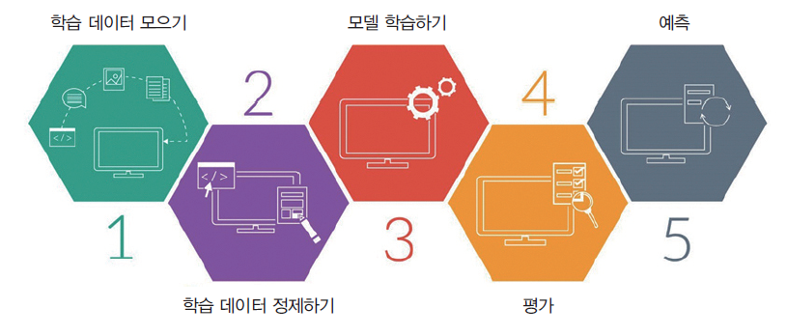
process of machine learning

Slide 35
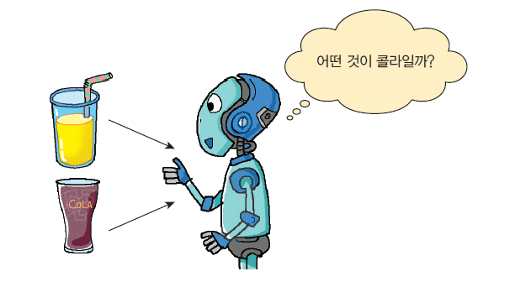
machine learning examples
Suppose we are asked to create a system that determines whether a drink is cola or juice . In machine learning, these systems are called " models " , and these models are created through a process called " training " .

Slide 36
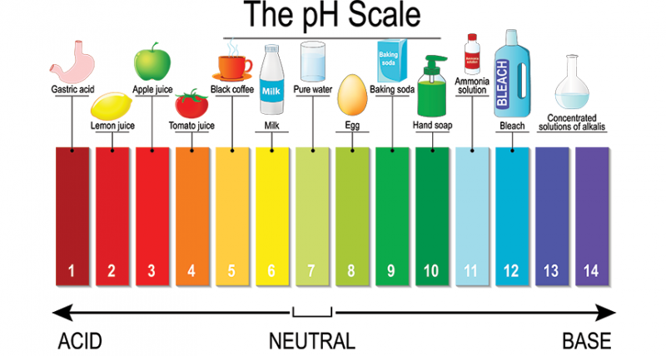
what features ?
us choose two things : color ( wavelength ) and acidity ( real number ) . We hope to be able to distinguish these two factors alone . These are called " features " .

Slide 37
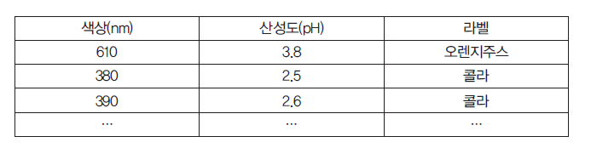
data collection

Slide 38
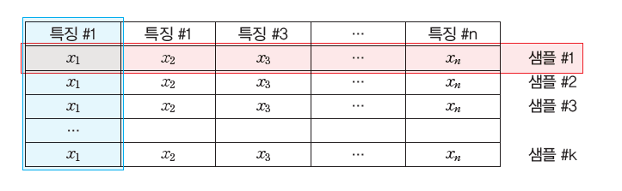
Structure of training data
#2

Slide 39
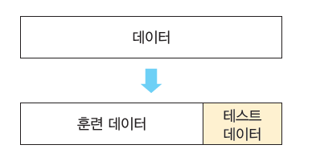
training and test data
Machine learning always requires training data and test data .

Slide 40
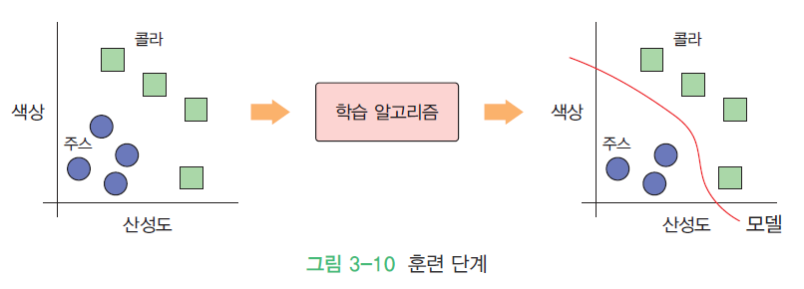
training phase

Slide 41
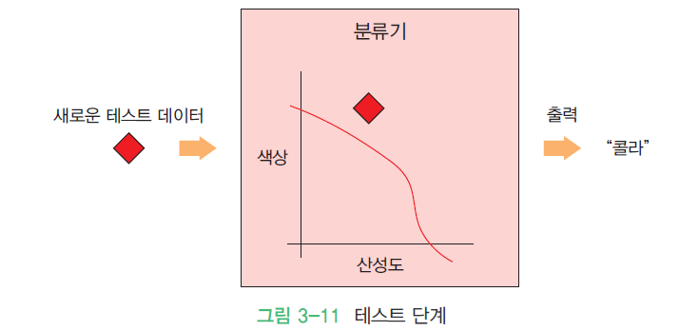
test step

Slide 42
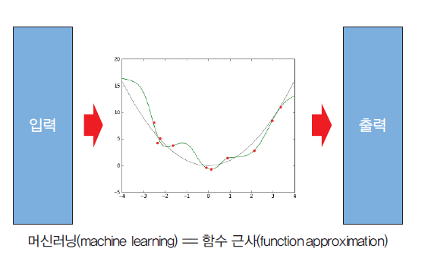
Select model
The next step is to select a machine learning model .
There are many models that many researchers have created over the years .
In our case we only have two features, color and acidity, so let's use a very simple linear model .

Slide 43
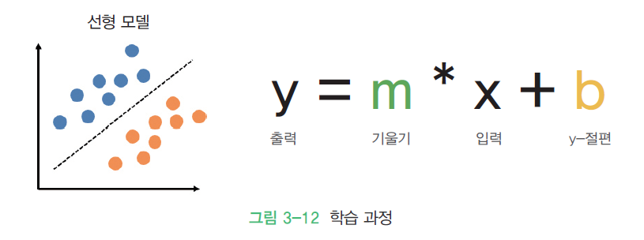
linear model

Slide 44
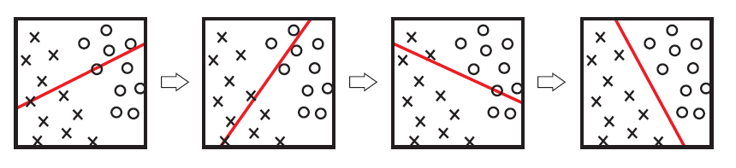
learning
At first, W and b are initialized with random values, and the output is predicted with the input values .
Compare this output to the exact value and adjust the values of W and b to have a more accurate prediction.

Slide 45
evaluation
When training is complete, we need to evaluate the model to see if it is good or bad .
Use test data
A typical training data to test data ratio is 80:20 or 70:30 .

Slide 46
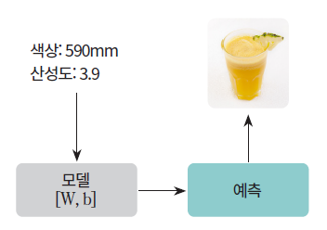
prediction
At this stage, the machine learning system answers our questions .
For example, you can ask the machine learning system which drink has a color of 600 nm and an acidity of 1.5 .
As trained, the machine learning system can predict whether a given drink is cola or juice, given its color and acidity .

Slide 47
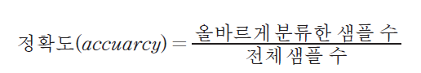
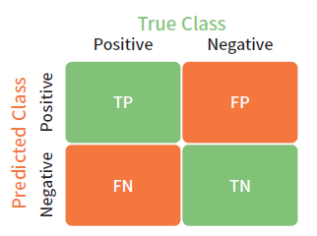
machine learning algorithms
accuracy
confusion matrix

Slide 48
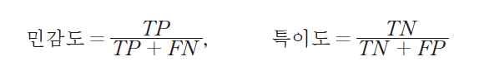
confusion matrix
If it correctly predicts a positive as a positive, it is said to be a TP (True Positive) . If True is added in front , it means that prediction and actuality are the same .
When a positive is incorrectly predicted as a negative, it is called a false negative (FN ) . If False is added in front , it means that the prediction is different from the actual .
When a negative is incorrectly predicted as a positive, it is called a false positive (FP) .
If it correctly predicts a negative as a negative, it is said to be a true negative (TN ) .

Slide 49
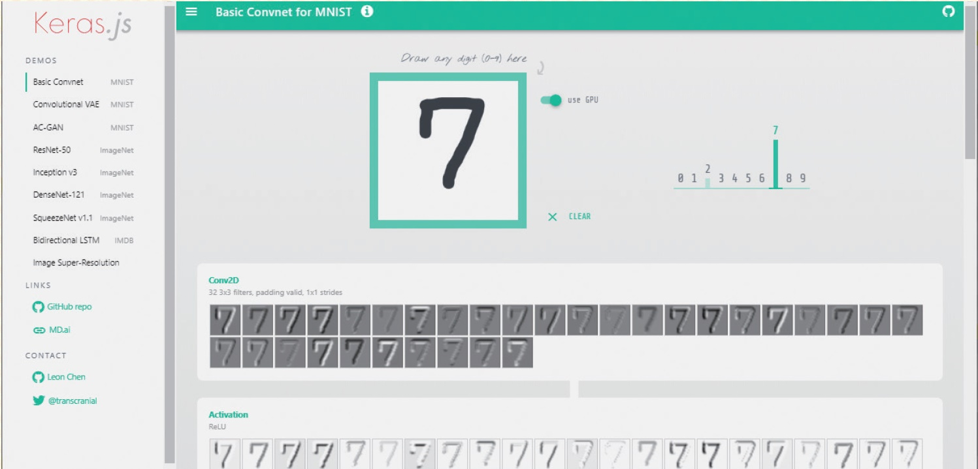
Lab: Experience Machine Learning
https://transcranial.github.io/keras-js/#/

Slide 50
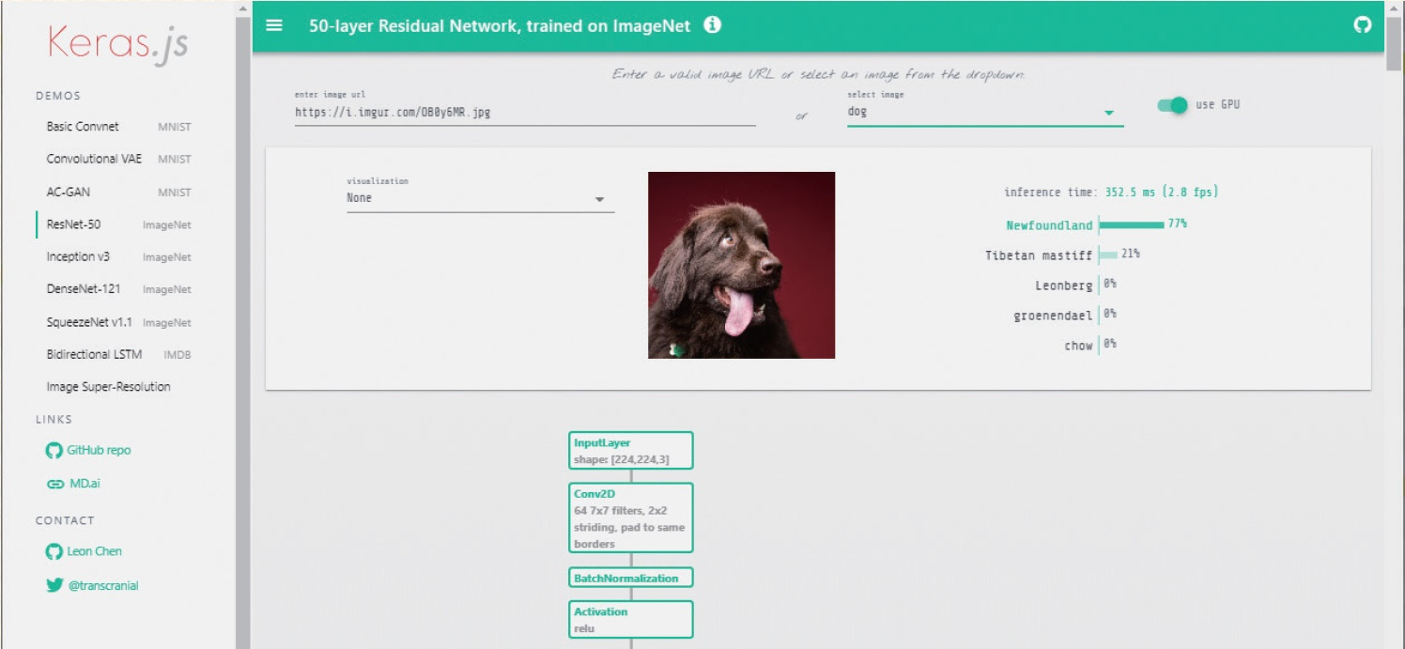
Lab: Experience Machine Learning
https://transcranial.github.io/keras-js/#/

Slide 51
Where is machine learning used ?
These are areas where there is complex data to look at , and decisions must be made based on this data .
When the rules and formulas are too complex to write in a program, such as image recognition or voice recognition
When data characteristics are constantly changing and the program needs to be constantly changing, such as stock trading, energy demand forecasting , or shopping trend forecasting.
A system that determines which ads a buyer is most likely to click on
Video recommendation system on Netflix
self- driving car

Slide 52
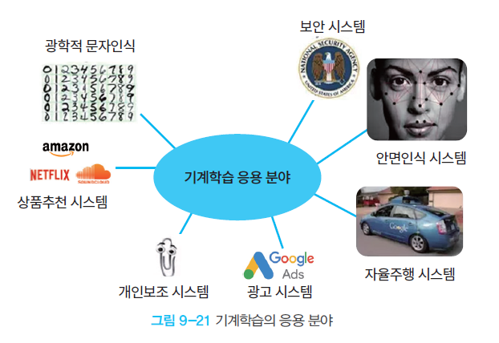
Uses of Machine Learning
Machine learning is primarily used when designing and programming explicit algorithms is difficult or impossible because the number of possible cases in a problem is so great.

Slide 53
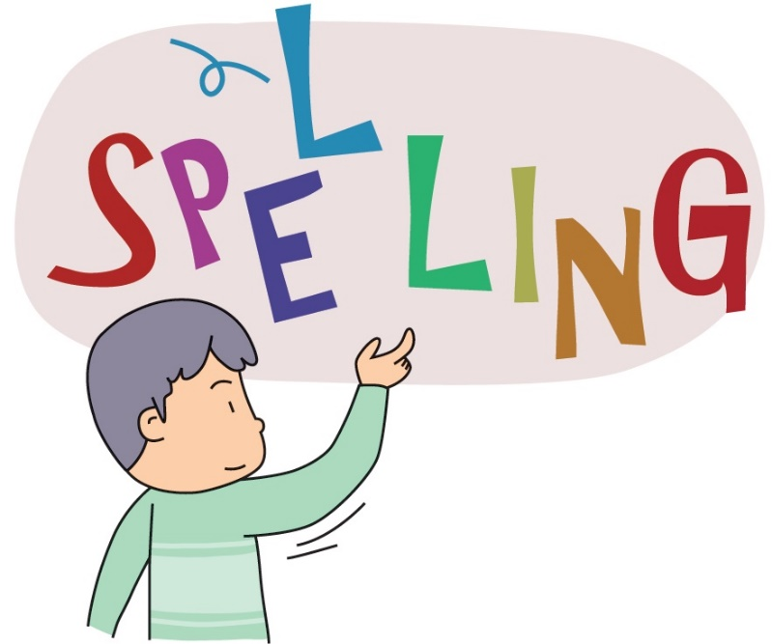
The practical value of machine learning as a programmer
The first is that programming time can be reduced .
For example, let's say you are developing a program to correct spelling errors .
Traditional Method : Can be written using many spelling rules . -> It takes a lot of time
Using machine learning : If you have a lot of examples , you can learn and complete a reliable program in a short time .

Slide 54

The practical value of machine learning as a programmer
Second, custom products can be easily developed .
For example, let's say you have a Korean spelling correction program written . The product is so successful that it wants to expand it with 30 language versions .
The traditional method : Writing anew for each language would take a significant amount of time, many years or more .
Using Machine Learning : It 's so easy . All you need is an example .

Slide 55

The practical value of machine learning as a programmer
Thirdly, machine learning can solve problems for which no algorithm can come to mind as a programmer .
For example, write a program for a computer to recognize a person's face.
The Traditional Method : Writing these problems is a task that requires a lot of knowledge and experience in computer vision .
Using machine learning : just show the program a bunch of examples and the problem is solved . Isn't that convenient ?

Slide 56
Summary
Machine learning is a field of artificial intelligence , and it is a research field for imparting learning functions to computers .
Machine learning is largely divided into supervised learning and unsupervised learning depending on the presence or absence of a “teacher” . There is also reinforcement learning .
Supervised learning can be largely divided into regression and classification . Regression is the process of learning a given input - output pair and predicting a reasonable output value when a new input value comes in . Classification : The division of an input into two or more types .
Unsupervised learning means that the computer classifies the inputs on its own without a “teacher” . In unsupervised learning, similar data are collected by analyzing the correlation of data .
In reinforcement learning, an external punishment or reward is given whenever the computer takes an action .

Slide 57
Q&A

